Slide 1
Discrete Probability Distributions

Slide 2
Discrete Probability Distributions
Binomial distribution
Negative Binomial distribution
Multinomial distribution
Hypergeometric distribution
Poisson distribution
Geometric distribution

Slide 3
The Bernoulli Process
1. The experiment consists of repeated trials.
2. Each trial results in an outcome that may be classified as a success or failure.
3. The probability of success, denoted by p, remains constant from trial to trial.
4. The repeated trials are independent.
Notes:
Examples: Tossing a coin, Defective or Non defective, Pass/fail

Slide 4
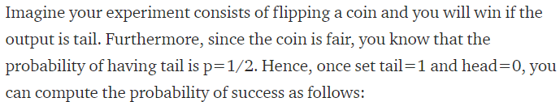

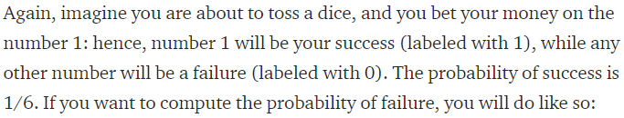


Slide 5
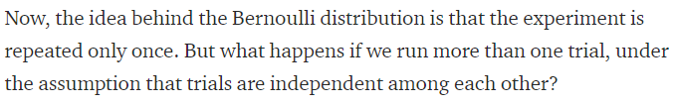

Slide 6


Slide 7
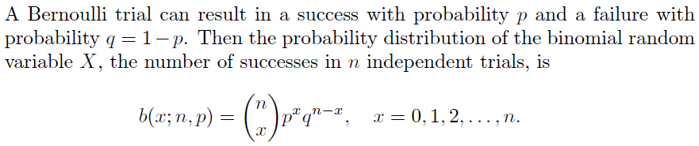

Slide 8

Binomial Distribution
The number X of successes in n Bernoulli trials is called a binomial random variable.
The probability distribution of this discrete random variable is called the binomial distribution.
The probability of a success in a binomial experiment can be computed with this formula:

Slide 9
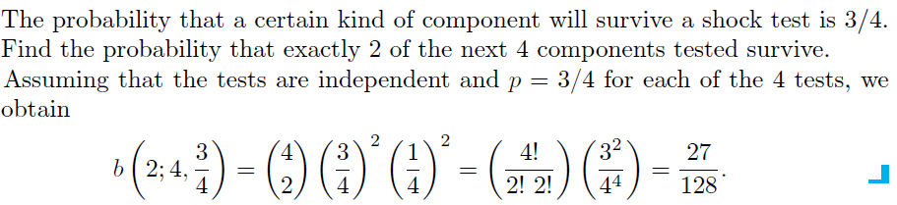

Slide 10
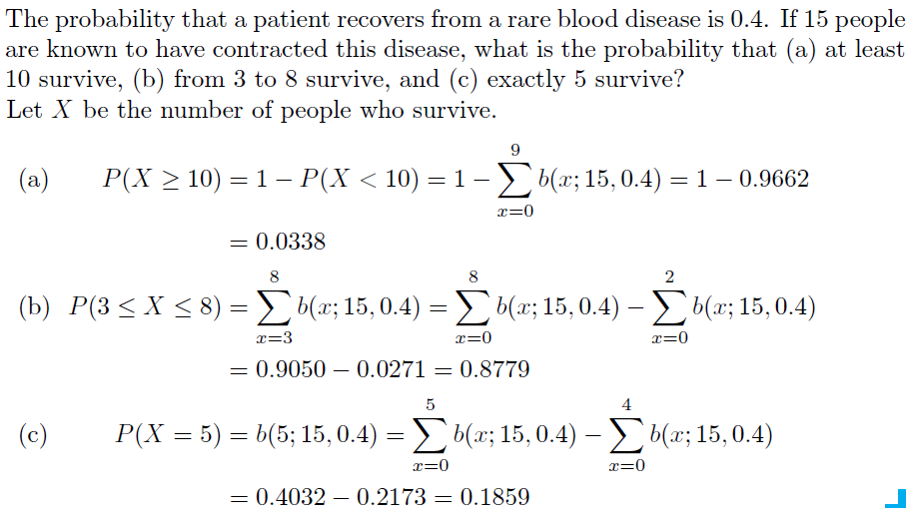

Slide 12
Multinomial Experiments
Each trial in an experiment has more than two outcomes.
the probabilities for each trial remain constant.
the outcomes are independent for a fixed number of trials.
Events must also be mutually exclusive.

Slide 13
Examples of Multinomial Experiments
52 playing cards.
Rolling a dice.
a survey might require the responses of “approve,” “disapprove,” or “no opinion.”

Slide 14
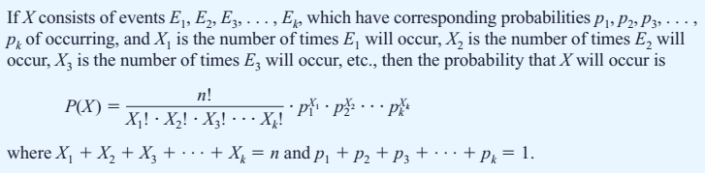
Multinomial Distribution

Slide 15
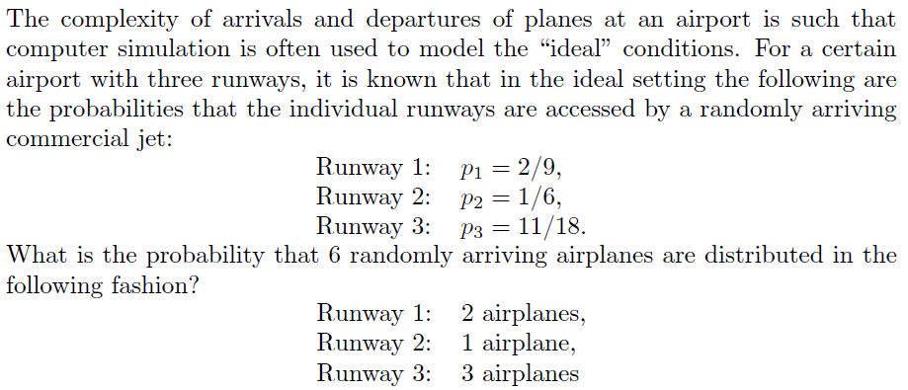
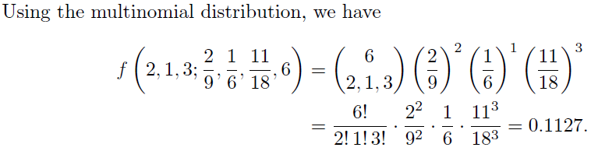

Slide 16

The mean and variance of Multinomial Distribution is given as:
The mean of Multinomial Distribution is: $µ=np$
${\text{The} \text{variance} \text{of} \text{Mult}\text{inomial} \text{Distribution} \text{is}\text{:} σ}^{2}=np(1−p)$

Slide 17
Hypergeometric Experiment
The result of each trial can be classified as Success or Failure.
The probability of success changes on each trial.
Successive trials are dependent.
The experiment is repeated a fixed number of times.

Slide 18
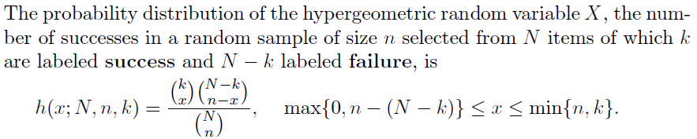
Hypergeometric Distribution

Slide 19
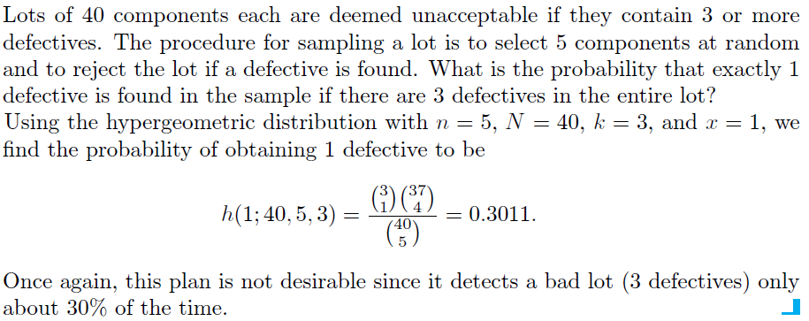

Slide 20
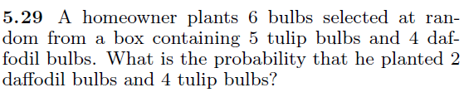

Slide 21


Slide 22
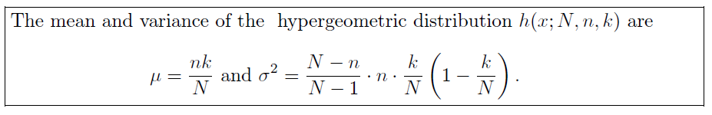

Slide 23
Further Explanation to Hypergeometric Distribution

Slide 24
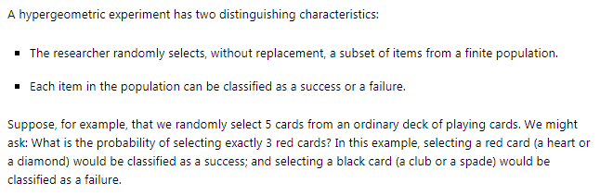

Slide 25
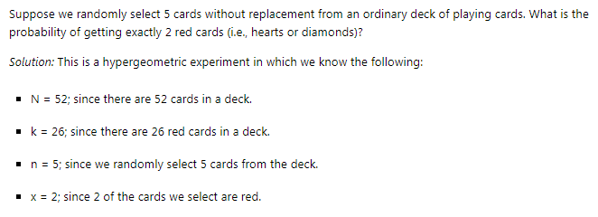

Slide 26
In binomial distribution the probability of success remain constant from trail to trail
In Hypergeometric distribution the probability of success changes from trail to trail.
Binomial Distribution is the trails with replacement.
Hypergeometric Distribution is the trails without replacement.

Slide 27

The mean and variance of Binomial Distribution and Hypergeometric Distribution are related as

Slide 28

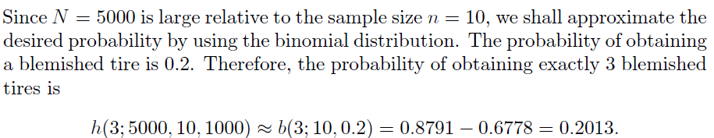

Slide 29
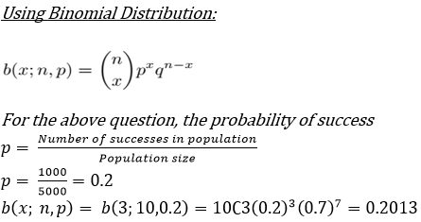

Slide 30
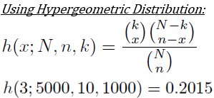

Slide 31


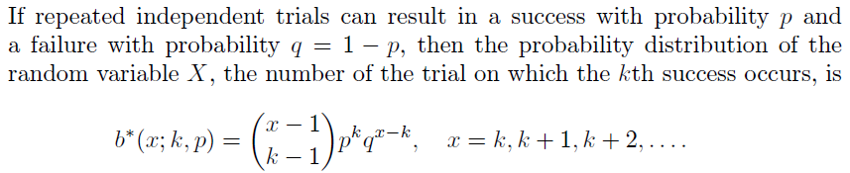

Slide 32
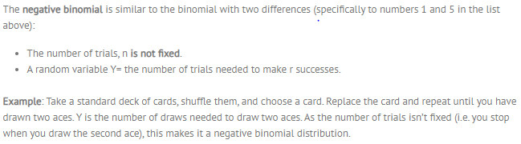
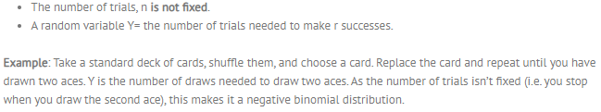
Similarity to Binomial Distribution

Slide 33

Take the example of flipping a coin. Suppose that getting a head is the success of experiment. Now we have to keep on flipping the coin before we get a head. So there are no fixed number of trails you have to do before getting a success. Or in other word you ca say that how many failed attempts you have to make before success.

Slide 34
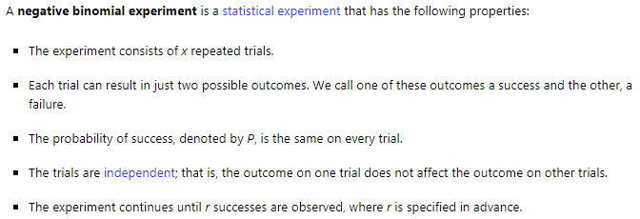

Slide 35
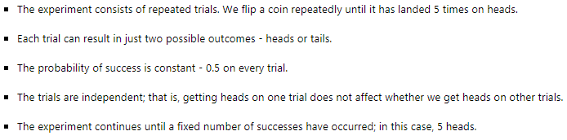

Slide 36
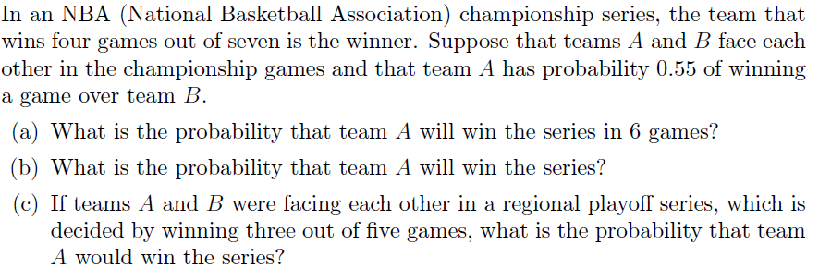
This is a negative binomial distribution in which we know the following:
p=0.55 for team A
x= 6; number of games to play for getting 4th success
k= 4

Slide 37
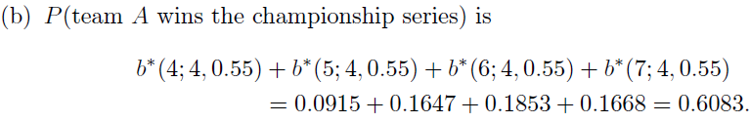
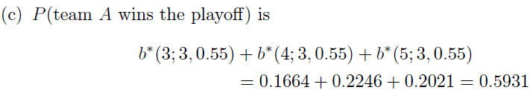

Slide 38
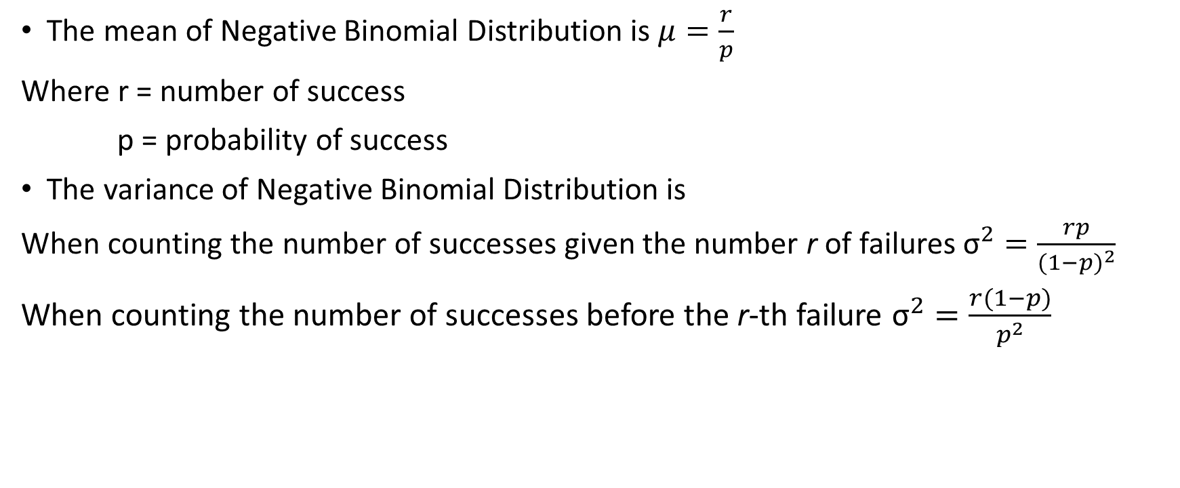
The Mean and Variance of Negative Binomial Distribution
The mean of Negative Binomial Distribution is $μ=\frac{r}{p}$
Where r = number of success
p = probability of success
The variance of Negative Binomial Distribution is
When counting the number of successes given the number r of failures ${\text{σ}}^{2}=\frac{rp}{{(1−p)}^{2}}$
When counting the number of successes before the r-th failure ${\text{σ}}^{2}=\frac{r(1−p)}{p^{2}}$

Slide 39
Geometric Experiment
The outcomes of each experiment/trial can be classified into one of the two categories (Success or Failure).
The probability of a success is the same for each experiment.
Each experiment is independent of all the others.
The experiment is repeated a variable number of times until the first success is obtained.

Slide 40
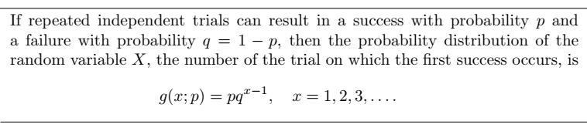
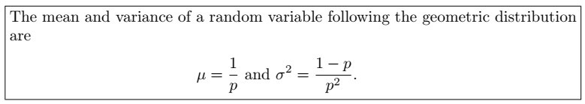
Geometric Distribution

Slide 41


Slide 42


Slide 43
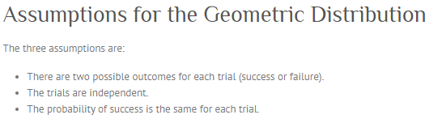
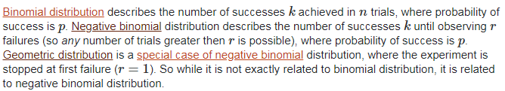

Slide 44



Slide 45
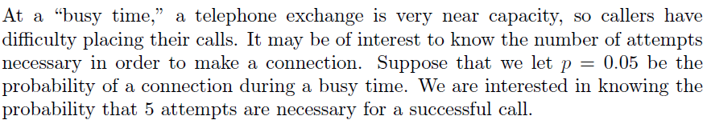


Slide 46

Poisson Distribution
Another important discrete distribution that is often used to model the frequency with which a specified event occurs during a particular period of time, is Poisson distribution.
The Poisson probability formula is:
Where “X” is the number of times the event occurs and λ is a parameter equal to the mean of X.

Slide 47



Slide 48
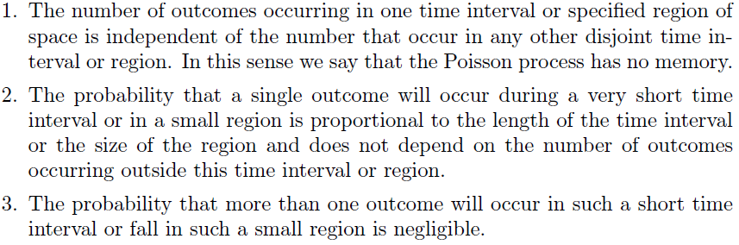

Slide 49
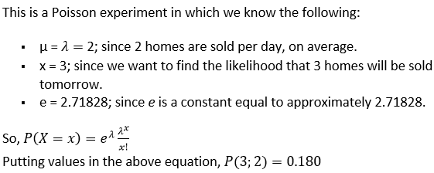


Slide 50




Slide 51
